Slide 1

COMP5310
Presentation by Faiyam Islam

Slide 2
Agenda
Introduction and Problem Statement
Understanding the data
Data Preprocessing
Data Summarisation and Analysis
Discussion

Slide 3

Introduction and Problem Statement
Heart disease is the leading cause of death worldwide, and early detection plays a critical role in preventing adverse health conditions.
Traditional diagnostic methods often rely on invasive procedures and subjective interpretations, making them time-consuming and costly.
By leveraging the power of data analysis, we aim to report useful insights to assist healthcare professionals in making accurate and timely diagnosis.

Slide 4

Understanding the Data
Description
The dataset consists of information related to heart failure prediction, containing various features that could potentially contribute of heart disease occurrences
The data was collated from different datasets in the UCI Machine Learning Repository:
https://archive.ics.uci.edu/ml/machine-learning-databases/heart-disease/

Slide 5
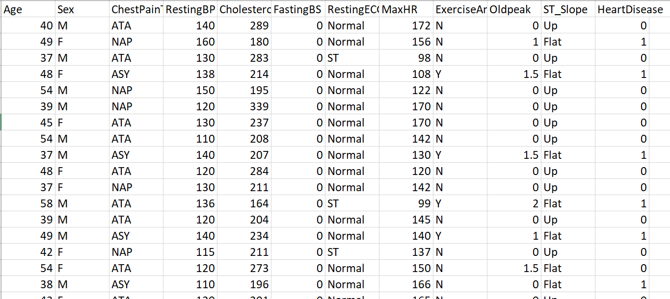
Understanding the Data
Features
Figure 1: Attributes of the heart dataset

Slide 6
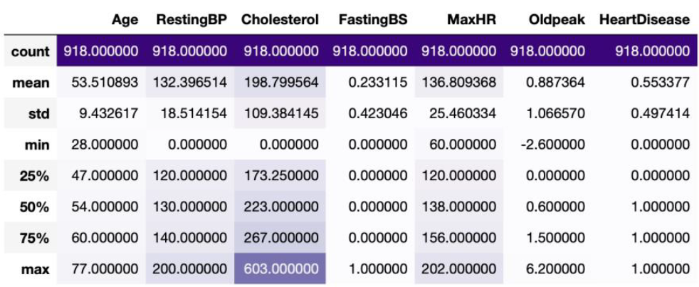
Understanding the Data
Key insights
Categorical predictors: Sex, ChestPainType, RestingECG, ExerciseAngina, ST_Slope
Numerical predictors: Age, RestingBP, Cholesterol, FastingBS, MaxHR, Old peak
Desrciptive statistics reveals that FastingBS and HeartDisease are binary variables with minimum and maximum values of 0 and 1
Categorical predictors aren’t shown
Cholesterol has the highest mean value with FastingBS having the lowest
Figure 2: Descriptive statistics of numerical predictors of heart dataset

Slide 7
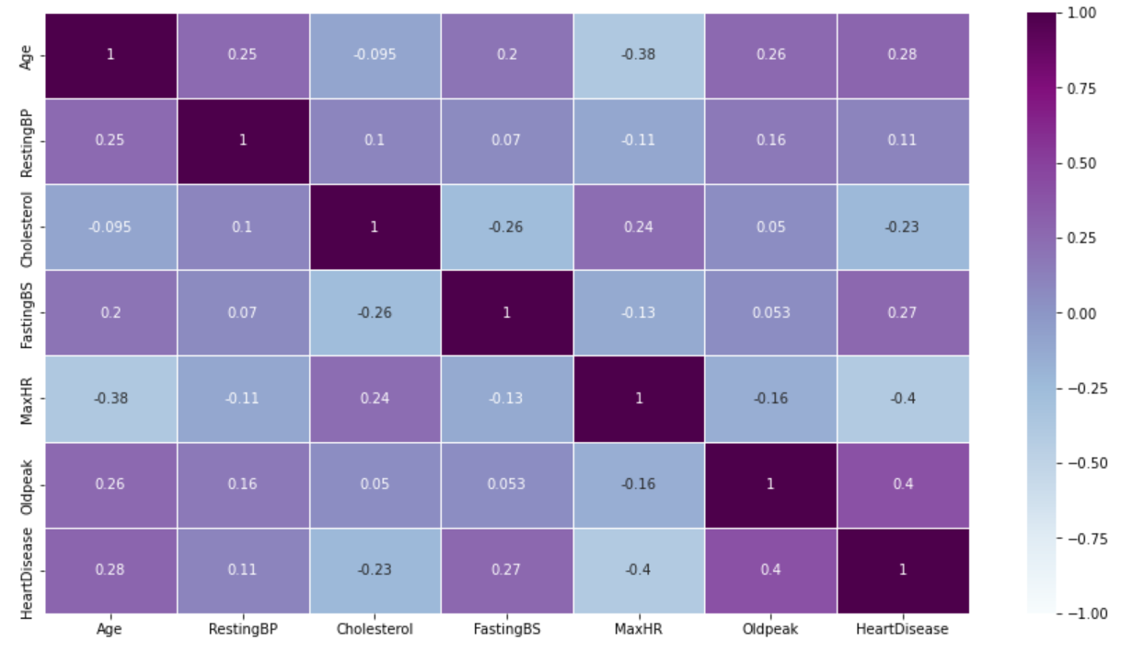
Understanding the Data
Figure 3: Correlation matrix of numerical predictors in heart dataset
Correlation matrix reveals that most predictors are not highly correlated
This is evident from R-score values, which did not exceed 0.7
No indication of issues with multicollinearity
MaxHR and HeartDisease exhibit negative correlation with R-score of -0.4

Slide 8
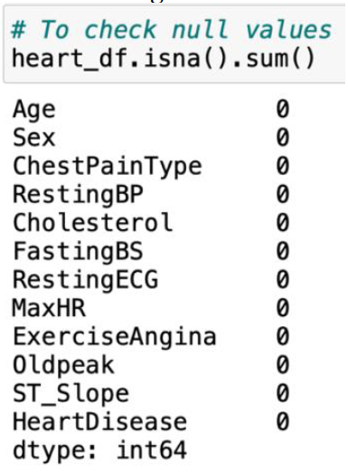
Data Preprocessing
Figure 4: Checking null values on heart dataset
Data Transformation
No null values found in the dataset using the isna().sum() command

Slide 9
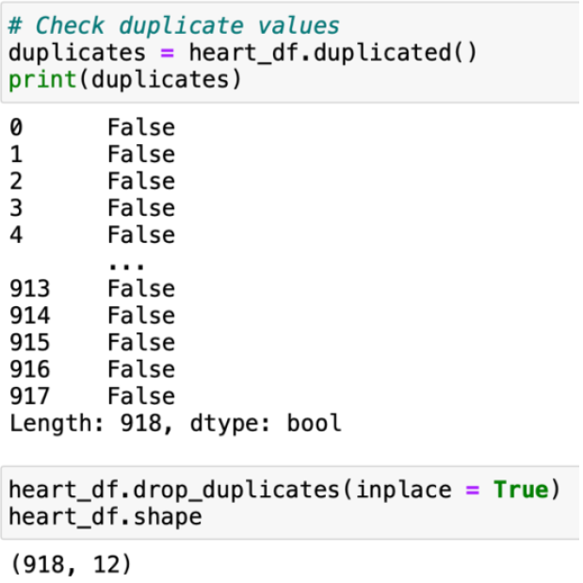
Data Preprocessing
No duplicate values found in the dataset using the .duplicated() command
Figure 5: Checking duplicate values on heart dataset

Slide 10
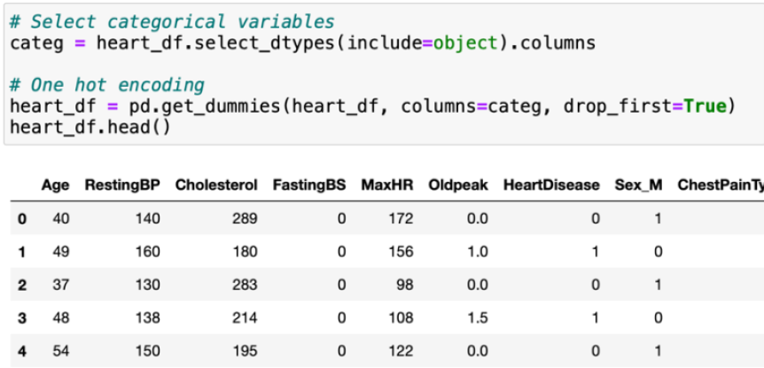
Data Preprocessing
Categorical predictors were converted to numerical predictors to allow for the use of machine learning models that require numerical inputs.
Figure 6: One-hot encoding on categorical variables in heart dataset

Slide 11
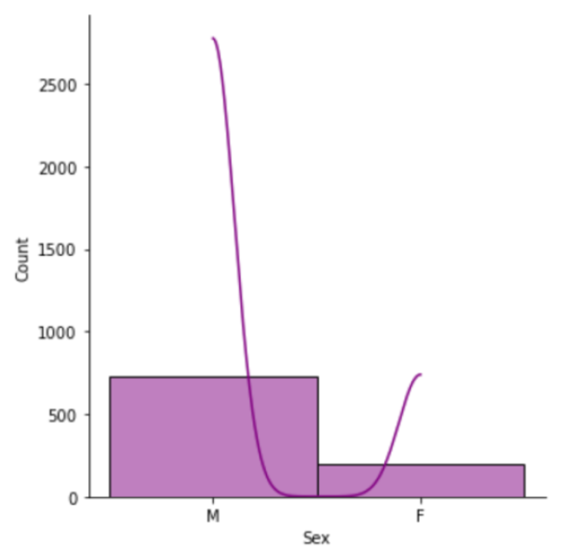
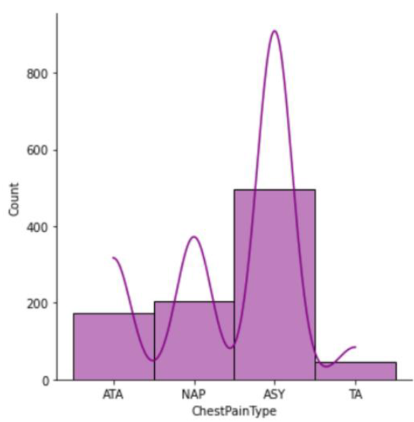
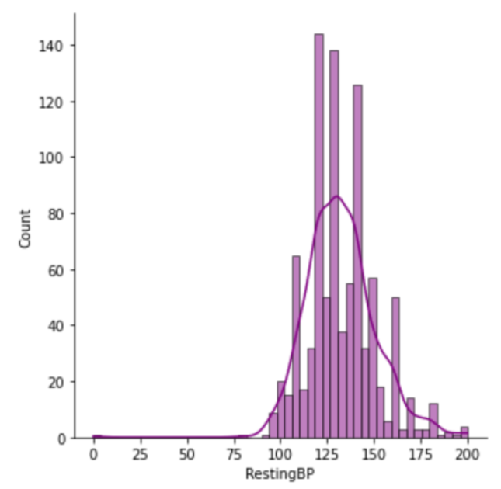
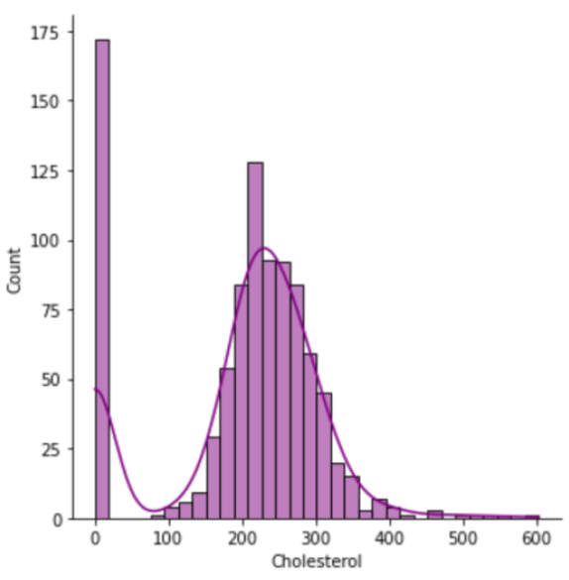
Data Summarisation and Analysis
Plot 1: Histogram of patient’s sex
Plot 2: Histogram of patient’s ChestPainType
Exploratory Data Analysis
There are more males than females in the sample
The most frequent chest pain type experienced by patients is Asymptomatic, whereas Typical Angina is the least common
Histogram on RestingBP variable has a left-tail distribution with mode around 120-140 resting blood pressure
Mode for Cholesterol levels seems to be 0, which is not possible
Further data transformation has been taken to remove all zeros
Plot 3: Histogram of patient’s RestingBP
Plot 4: Histogram of patient’s Cholesterol

Slide 12
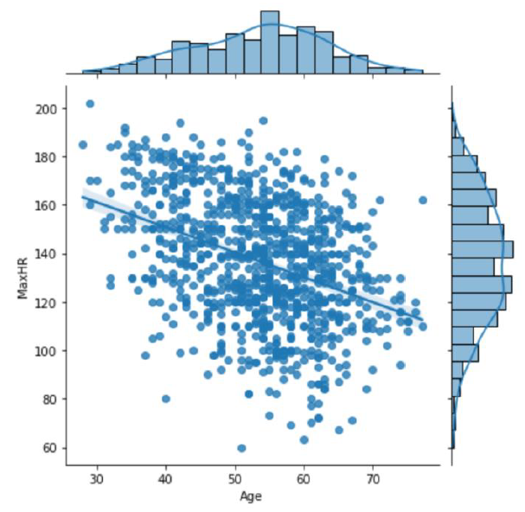
Data Summarisation and Analysis
Plot 5: Jointplot of MaxHR against Age
Jointplot visualises a negative relationship between MaxHR and Age
Presence of a few outliers, removal of these data points could potentially strengthen the bivariate relationships between variables
Histograms on the top and right side allows us to understand where most of the data lies which is around ages 50 and MaxHR of 140.

Slide 13
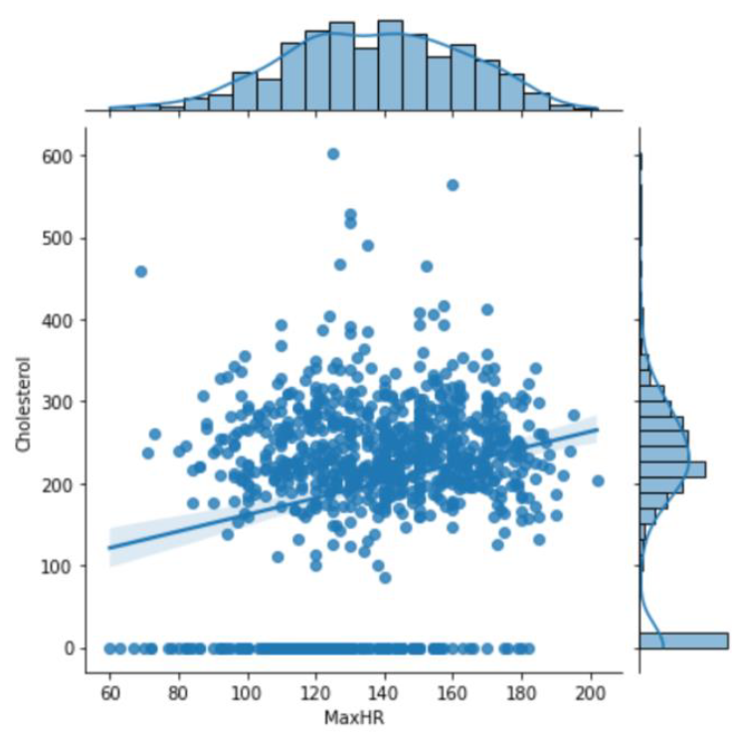
Data Summarisation and Analysis
Plot 6: Jointplot of Cholesterol against MaxHR
Bivariate relationship between MaxHR and Cholesterol is positive
Could indicate that patients with higher maximum heart rate generally tend to have higher Cholesterol levels
We cannot confirm this is a strong relationship due to the various outliers around 500 to 600 Cholesterol levels as shown in this plot

Slide 14
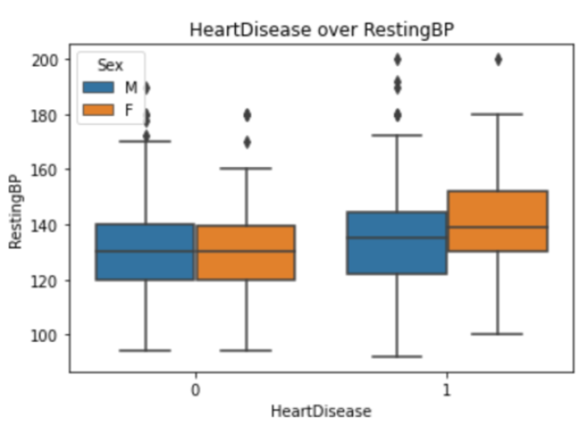
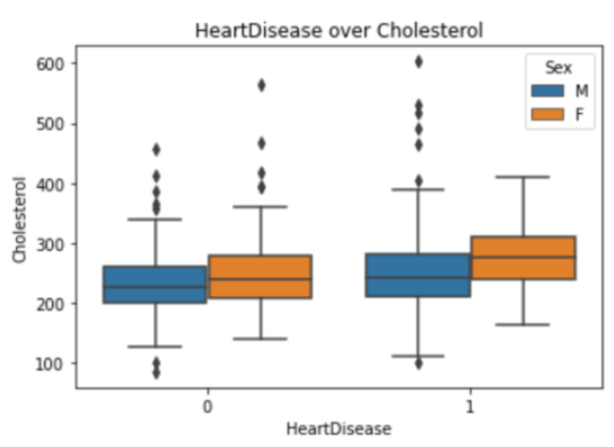
Data Summarisation and Analysis
Plot 7: Boxplot of HeartDisease over RestingBP
Potential outlier detection through box plot visualisations
Boxplot of HeartDisease over RestingBP and boxplot of HeartDisease over Cholesterol had various zeros, these were removed for better accuracy during model deployment and evaluation metrics are applied
Plot 8: Boxplot of HeartDisease over Cholesterol

Slide 15
Discussion
What’s next?
This is a classification problem, the dataset has a variety of different data types, alluding to various model deployments possible
Logistic Regression, Multi-class classification, Naive Bayes, Decision Trees can be used as machine learning techniques for modelling
Evaluation metrics can range from Accuracy, Precision-Recall, F1 score and RMSE can be used when measuring the effectiveness of these models on the above supervised learning methods
Evidently, our results should indicate which variables are the key indicators and are the most prevalent when determining heart disease in these patients, hence answering the researchquestion

Slide 16
Thank you for listening!

